Slide 1

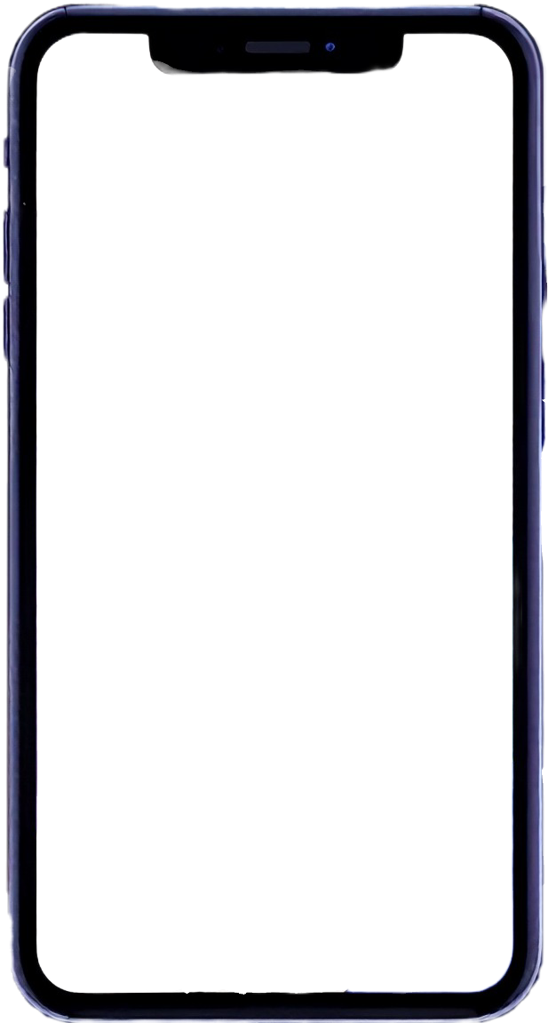
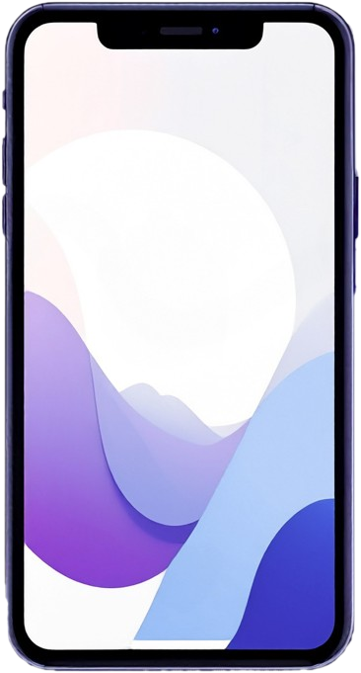



Slide 2

NeuroVibe: Real-Time EEG Aesthetic Analysis - Mobile vs Edge

Slide 3

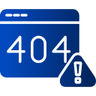



Our team - 404 Found
«Error? Not this time.»
We are a team of four CE/AIDE students passionate about neuroscience, engineering and technology.
Together, we developed NeuroVibe, an Android app that connects aesthetics and brainwaves.
Team members
Alex – Machine Learning Integration
Francesco – UI/UX Design
Mirco – Edge Deployment
Valentina – Data Processing

Slide 4


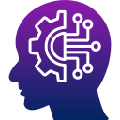










Introduction
Main objectives
Understand the link between aesthetics
and brain activity
Compare 2 architectures: mobile vs edge
Implement real-time EEG signal processing
Integrate and test an ML model on-device

Slide 5

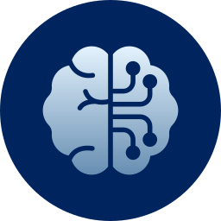

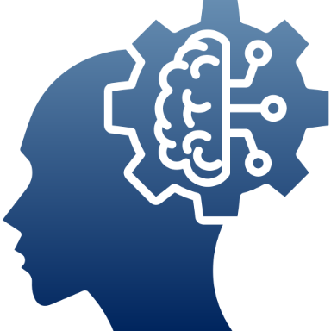
Background
EEG signals & the concept of beauty
Electroencephalography (EEG) captures the brain’s electrical activity. Studies have linked specific patterns in EEG signals to the perception of beauty, engagement and emotional responses.
Neuroaesthetics
It’s the study of how the brain responds
to beauty, art, and aesthetic experiences.
It combines neuroscience, psychology
and philosophy to explore what makes
something “beautiful” and how this is
processed in the brain.
Related works
Our project is inspired by the study Recognizing Special Artpieces
through EEG: A Journey in
Neuroaesthetics Classification (Maurizio Palmieri, Marco Avvenuti,
Francesco Marcelloni and Alessio Vecchio)

Slide 6

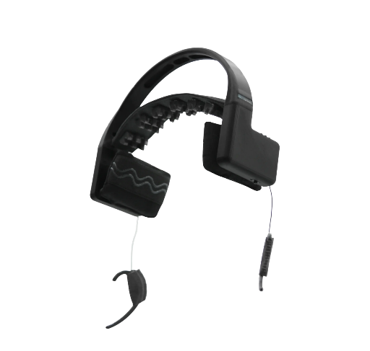
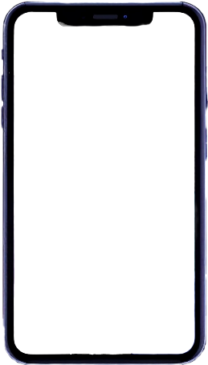





Mobile Architecture Overview
Wi-Fi connection
The MindRove Arc headset captures raw EEG signals and sends them to the Android app via Wi-Fi
MindRove headset
6 (+2) EEG channels
Electrodes: C5, C3, C1, C2, C4, C6
Electrode type: semi-dry, no gel needed
Battery: rechargeable LiPo
Android App
Language used: Kotlin

Slide 7
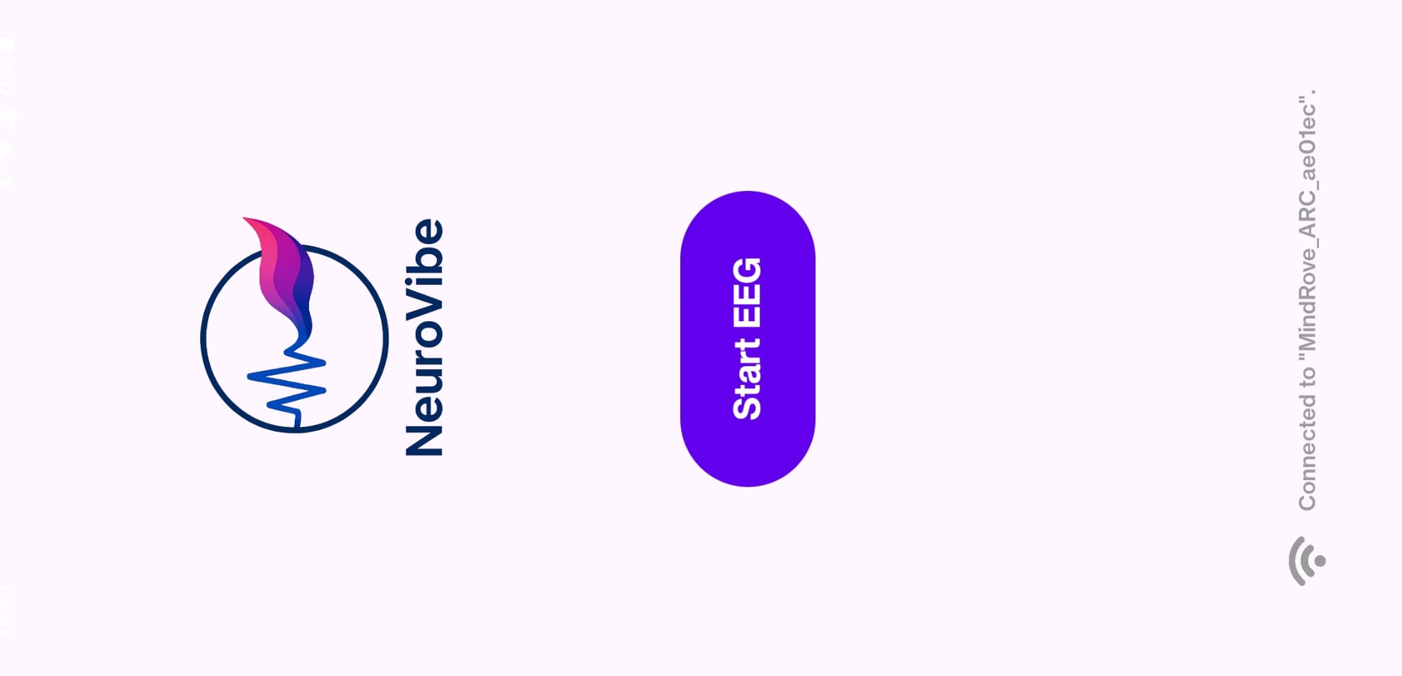



Mobile Architecture Overview
Data
Processing
Feature Extraction
Model Prediction

Slide 8

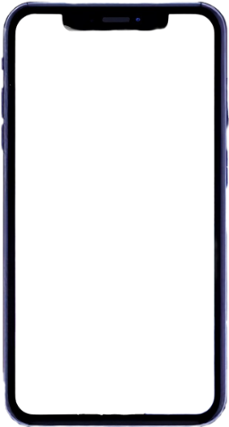

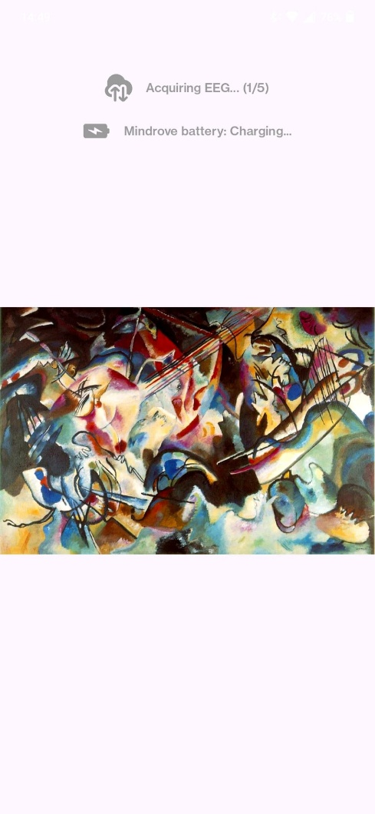
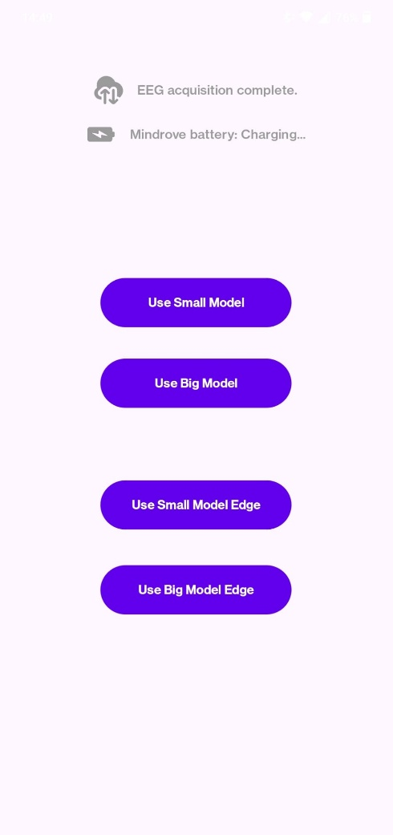
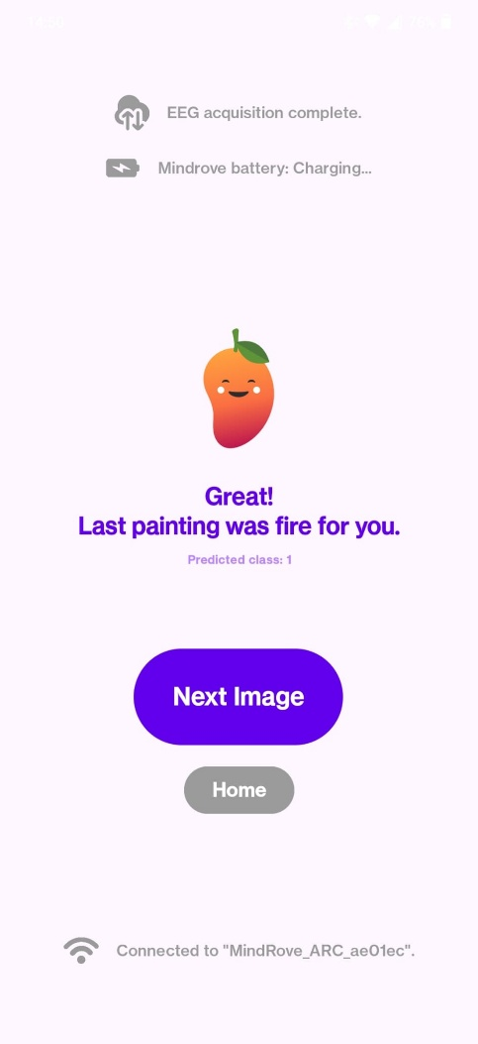
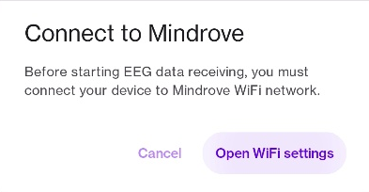
User Interface and Features

Slide 9
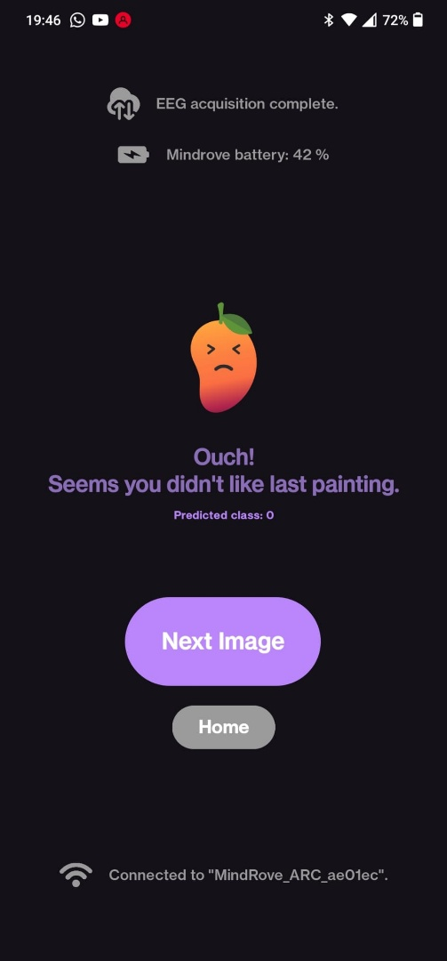
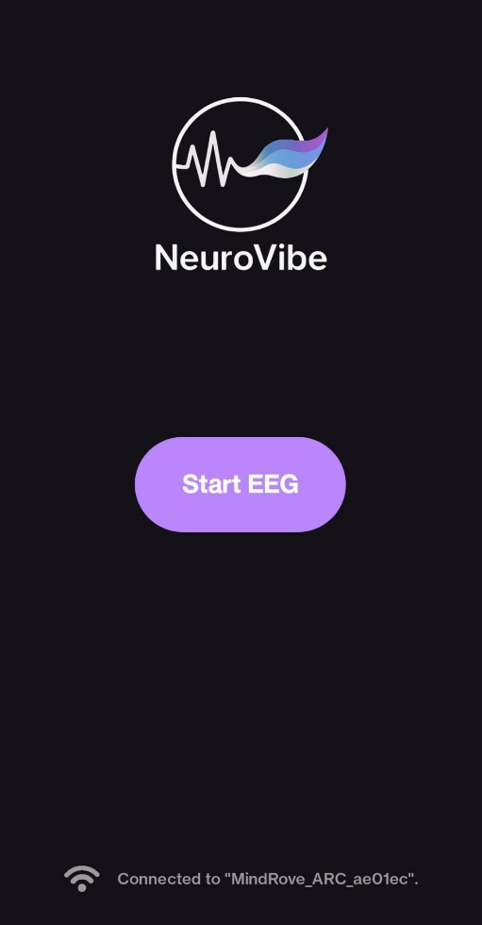
User Interface and Features

Slide 10


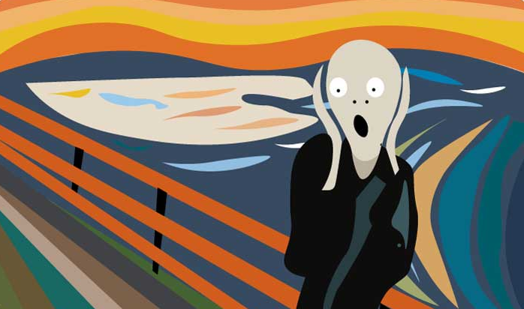




Data Processing: EEG Segmentation
Data obtained from the SensorData class, representing EEG channels and motion sensors, are saved as CSV files.
Total: 5 segments of 2 seconds each, resulting in 10 seconds of EEG recording per painting
2-second segment of EEG recording

Slide 11

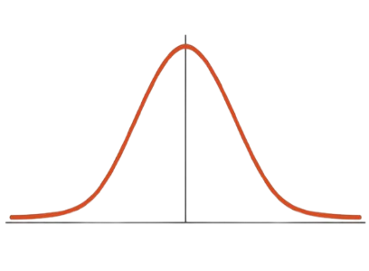
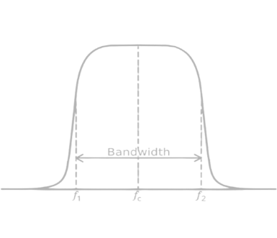

Data Processing: Pipeline
Data obtained from the SensorData class, representing EEG channels and motion sensors, are saved as CSV files.
Then, a band-pass filter (1–50 Hz) is applied to remove noise and irrelevant frequency components.
RAW DATA EXPORT
NORMALIZATION
BANDPASS FILTERING
FEATURE EXTRACTION
The raw EEG data is normalized to ensure consistency across channels and sessions.
A set of features is extracted from the filtered data to be used as input for the classification model.

Slide 12
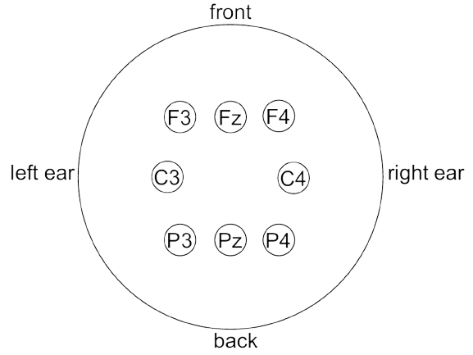


Electrode Remapping Strategy
The models were originally trained using features computed from a different set of EEG electrodes, requiring a channel remapping.
C5
C1
C2
C6

Slide 13
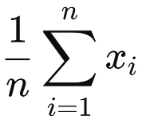
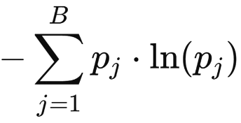


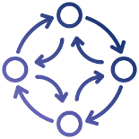
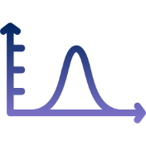


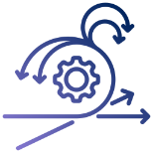
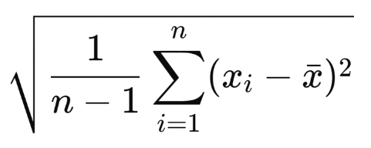

Feature Extraction
Mean =
Entropy =
Kurtosis =
B = bins number (20)
pj = estimated probability of bin j defined as nj / N
nj = number of values falling into bin j
N = total number of values in the sequence
n = sample size (number of data points)
x bar = sample mean (average of the sample data)
Min =
Std Deviation =
Max =

Slide 14

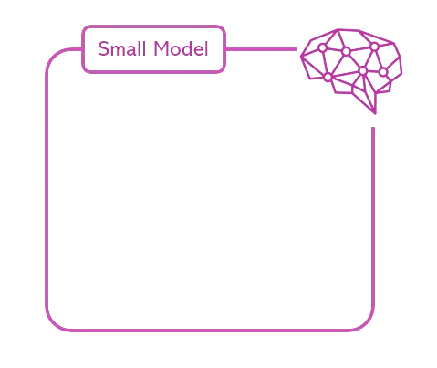
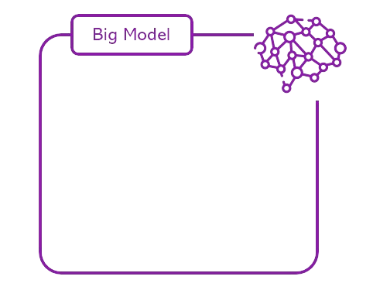
Machine learning Model
The small model (100 Neurons) is expected to be lightweight and optimized for speed and efficiency, making it ideal for low-resource device or real-time applications.
The big model (1000 Neurons) has a larger neural capacity, offering improved accuracy and better generalization at the cost of higher computation time.

Slide 15
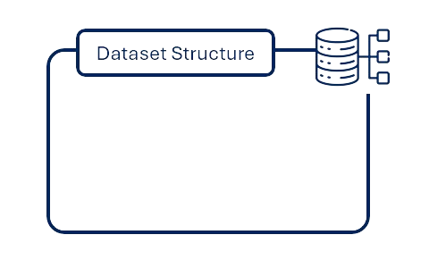



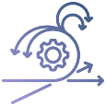
Machine learning Model
48 Features
EEG signals from 8 channels
For each channel 6 statistical features
Mean
Std Dev
Entropy
Kurtosis
Min
Max

Slide 16
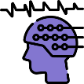

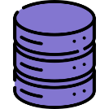
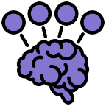
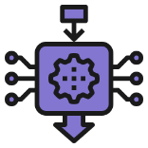
Machine learning Model
Inference Process
Capture 48-dimensional EEG feature vector
Prediction
Receive prediction (Valence: Piece/Special)
Models Location
Models are stored in the assets/ folder
Interpreter
Loaded using TensorFlow Lite’s Interpreter API
Model Selection
Run inference on selected TFLite model

Slide 17

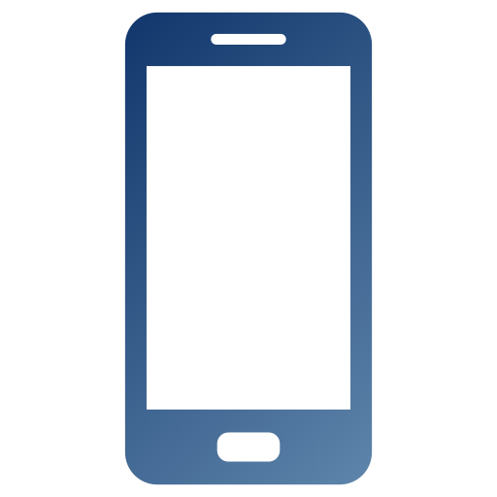


From Mobile to Edge: Extending NeuroVibe
Android App
MindRove headset
Wi-Fi connection
Edge Server

Slide 18
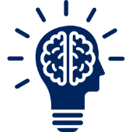
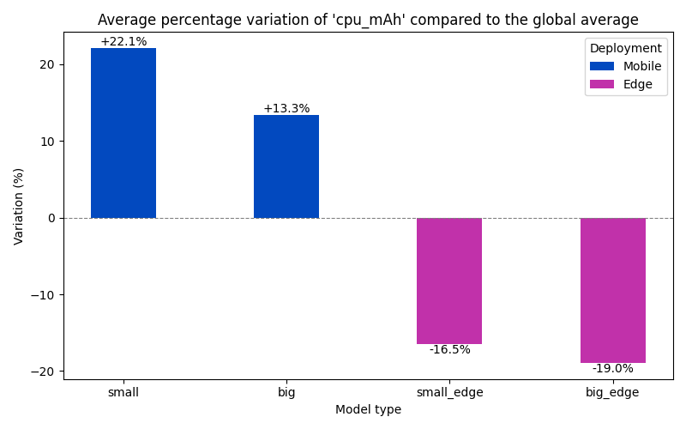
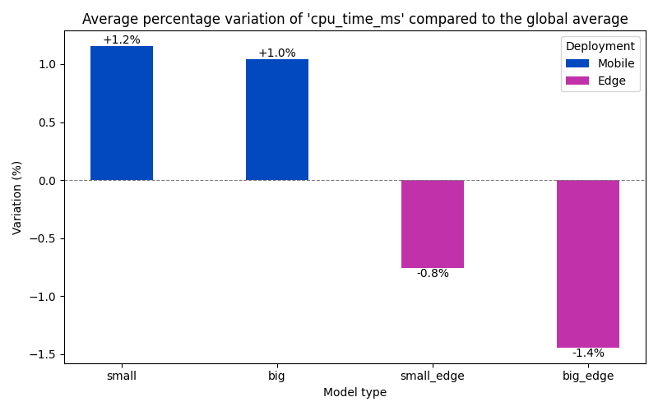
Evaluation and Results
Edge deployment significantly reduces both CPU consumption and execution time, enabling efficient and real-time EEG inference.

Slide 19
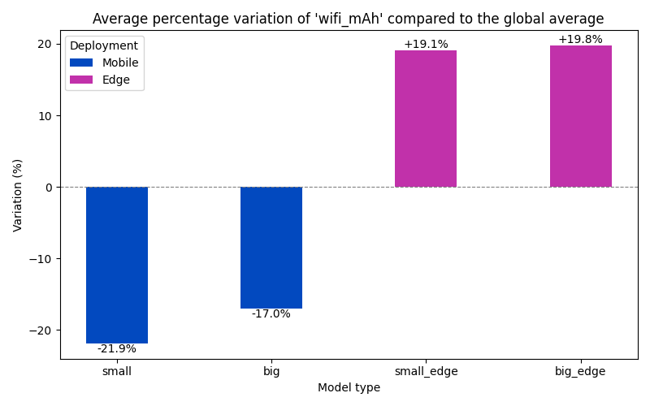
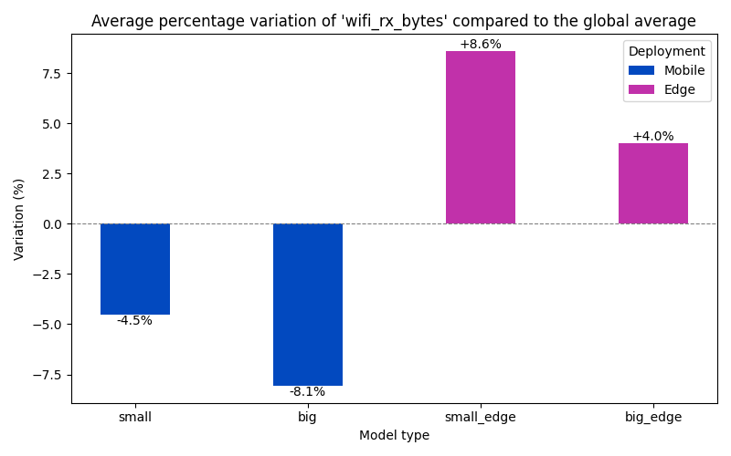
Evaluation and Results
Higher Wi-Fi energy and data usage observed with edge deployment, reflecting increased network interactions.

Slide 20
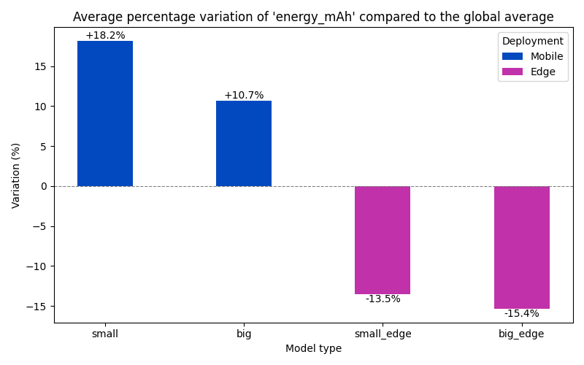
Evaluation and Results
Compared to mobile deployment, edge execution delivers substantial energy savings, optimizing performance without relying on cloud infrastructure.

Slide 21

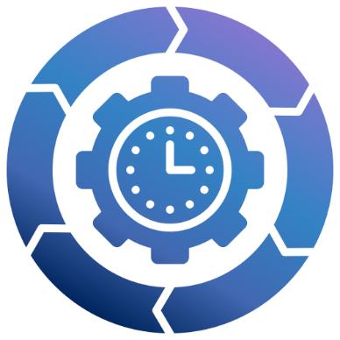
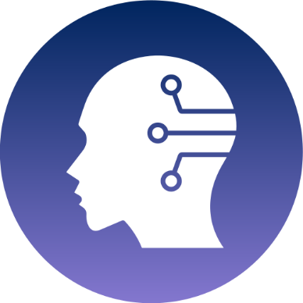
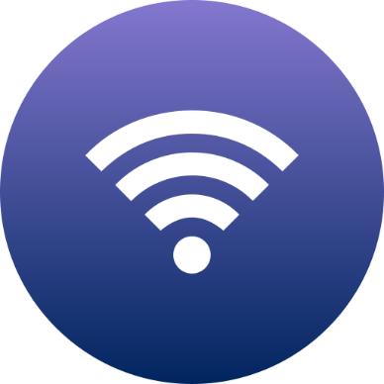
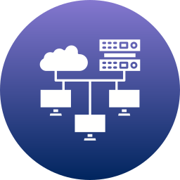
Conclusions
Key Strengths of NeuroVibe:
Edge computing enables real-time inference directly on nearby devices
Real-time EEG Signal Processing
Embedded Machine Learning
Wi-Fi connection

Slide 22







Future developments
Test the application with the
same electrode configuration used during model training.
Enable user accounts and access to shared image statistics.
Extend the application from the predefined gallery to any image,
by allowing users to add new ones.
Enable camera usage within the application.

Slide 23

Thanks for your attention!

